Slide 1

SOLID Principles

Slide 2

SOLID
Single-responsibility principle
Open-closed principle
Liskov substitution principle
Interface segregation principle
Dependency inversion principle

Slide 3






S - A class should only have a single responsibility, that is, only changes to one part of the software’s specification should be able to affect the specification of the class.
O - Software entities should be open for extension, but closed for modification.
Definition
L - Objects in a program should be replaceable with instances of their subtypes without altering the correctness of that program.
I - Many client-specific interfaces are better than one general-purpose interface.
D - One should depend upon abstractions, [not] concretions.

Slide 4
Single-responsibility principle
using System;
using System.Collections.Generic;
using System.ComponentModel.DataAnnotations;
using System.Net.Mail; using System.Text;
using System;
using System.Collections.Generic; using System.Text;
namespace SOLID_Principles
{
public class UserService
{
namespace SOLID_Principles
{
public class User
{
private readonly string _email; private readonly string _password;
public void Register(string email, string password)
{
if (!ValidateEmail(email))
throw new ValidationException("Email is not an email");
var user = new User(email, password);
public User(string email, string password)
{
_email = email;
_password = password;
}
SendEmail(user);
}
public void Login(string email, string password)
{
Console.WriteLine("Login");
}
}
public virtual bool ValidateEmail(string email)
{
return email.Contains("@");
}
public void SendEmail(User message) => Console.WriteLine("send message");
}
}
4

Slide 5
Open And Closed Principle
AFTER:
namespace SOLID_PRINCIPLES.OCP
{
public class Invoice
{
public virtual double GetInvoiceDiscount(double amount)
{
return amount - 10;
}
}
BEFORE:
namespace SOLID_PRINCIPLES.OCP
{
public class Invoice
{
public double GetInvoiceDiscount(double amount, InvoiceType invoiceType)
{
double finalAmount = 0;
if (invoiceType == InvoiceType.FinalInvoice)
{
finalAmount = amount - 100;
}
else if (invoiceType == InvoiceType.ProposedInvoice)
{
finalAmount = amount - 50;
}
else
{
finalAmount = amount - 30;
}
return finalAmount;
}
}
public enum InvoiceType
{
FinalInvoice, ProposedInvoice
};
}
public class FinalInvoice : Invoice
{
public override double GetInvoiceDiscount(double amount)
{
return base.GetInvoiceDiscount(amount) - 50;
}
}
public class ProposedInvoice : Invoice
{
public override double GetInvoiceDiscount(double amount)
{
return base.GetInvoiceDiscount(amount) - 40;
}
}
public class RecurringInvoice : Invoice
{
public override double GetInvoiceDiscount(double amount)
{
return base.GetInvoiceDiscount(amount) - 30;
}
}
}
5

Slide 6
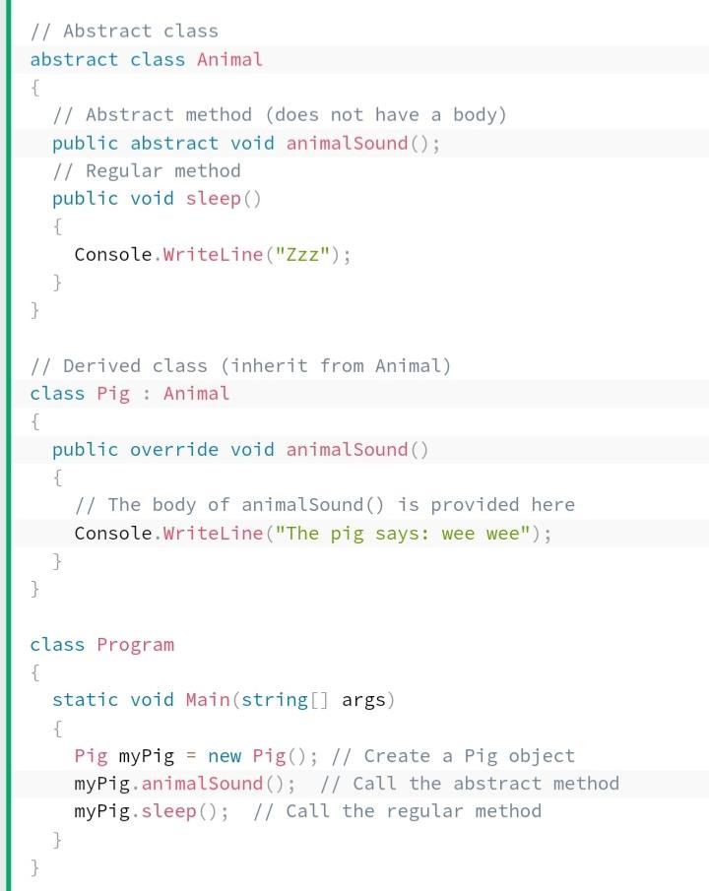
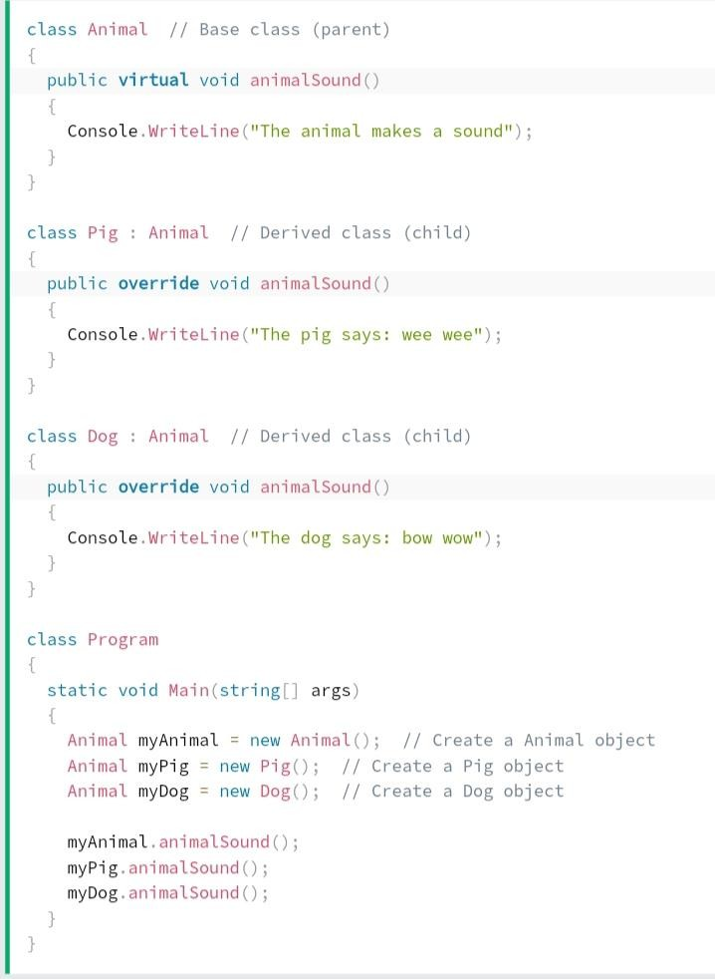
Liskov substitution principle

Slide 7
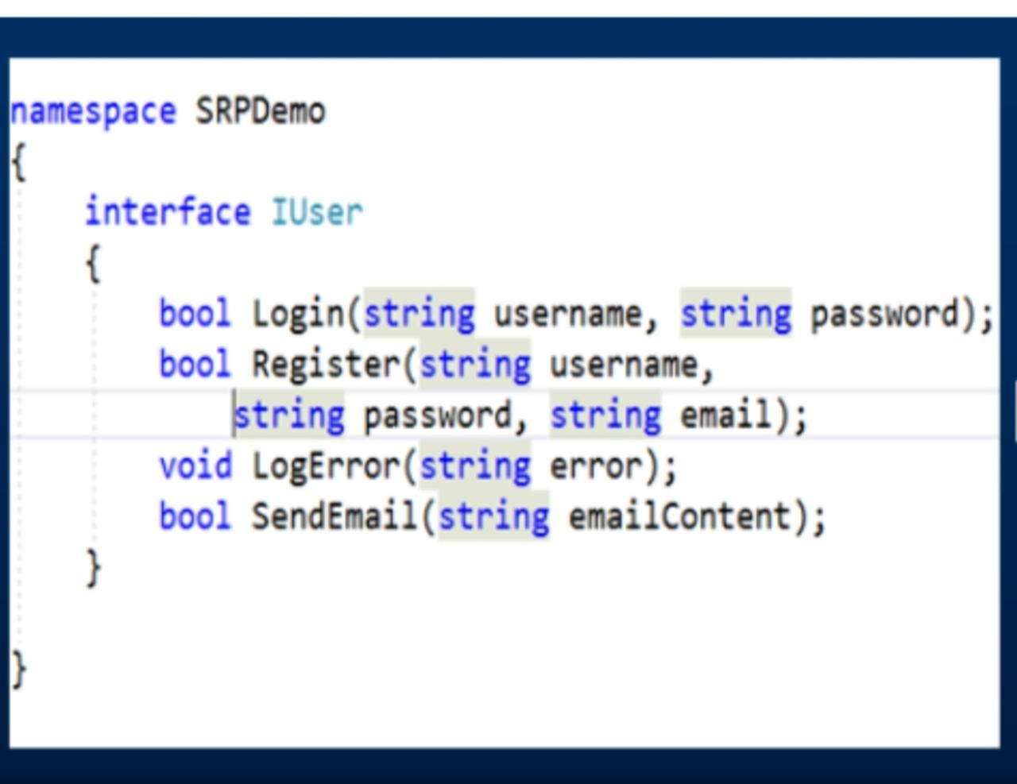
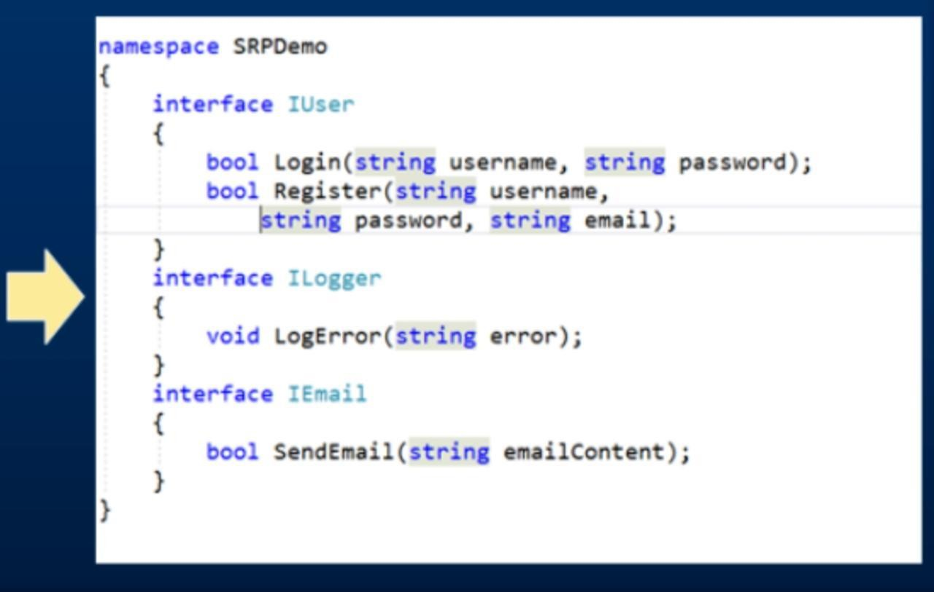
Interface Segregation Principle

Slide 8
Dependency Inversion
AFTER:
public interface ISalaryCalculator
{
float CalculateSalary(int hoursWorked, float hourlyRate);
}
public class SalaryCalculatorModified : ISalaryCalculator
{
public float CalculateSalary(int hoursWorked, float hourlyRate) => hoursWorked * hourlyRate;
}
public class DataAccessFactory
{
public static ISalaryCalculator GetSalaryCalculatorModifiedObject ()
{
return new SalaryCalculatorModified ();
}
}
public class EmployeeDetailsModified
{
private readonly ISalaryCalculator _salaryCalculator;
public int HoursWorked { get; set; }
public int HourlyRate { get; set; } public EmployeeDetailsModified()
{
_salaryCalculator = DataAccessFactory. GetSalaryCalculatorModifiedObject();
}
public float GetSalary()
{
return _salaryCalculator.CalculateSalary(HoursWorked, HourlyRate);
}
}
BEFORE:
public class SalaryCalculator
{
public float CalculateSalary(int hoursWorked, float hourlyRate) => hoursWorked * hourlyRate;
}
public class EmployeeDetails
{
public int HoursWorked { get; set; } public int HourlyRate { get; set; } public float GetSalary()
{
var salaryCalculator = new SalaryCalculator();
return salaryCalculator.CalculateSalary(HoursWorked, HourlyRate);
}
}

Slide 9



Thank you
for your time

